Slide 1
GunViolence w full moon date
File created on: 12/10/2020 3:43:39 PM

Slide 2
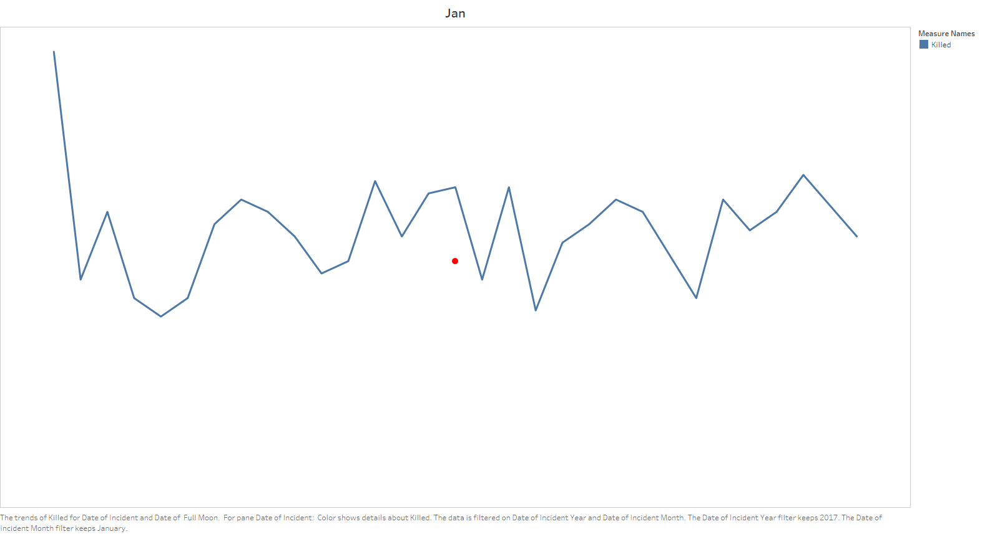

Slide 3
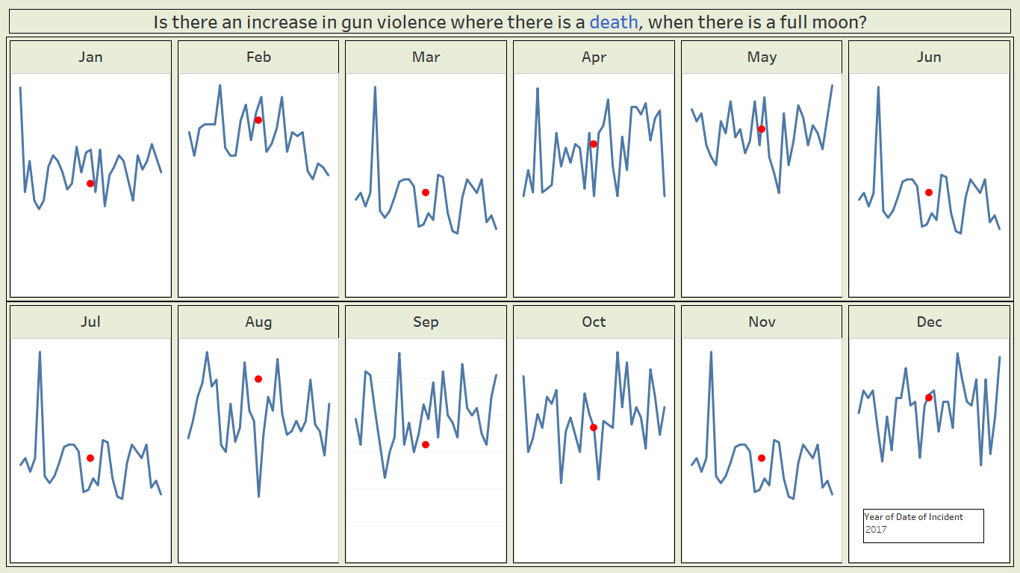

Slide 4


Slide 5
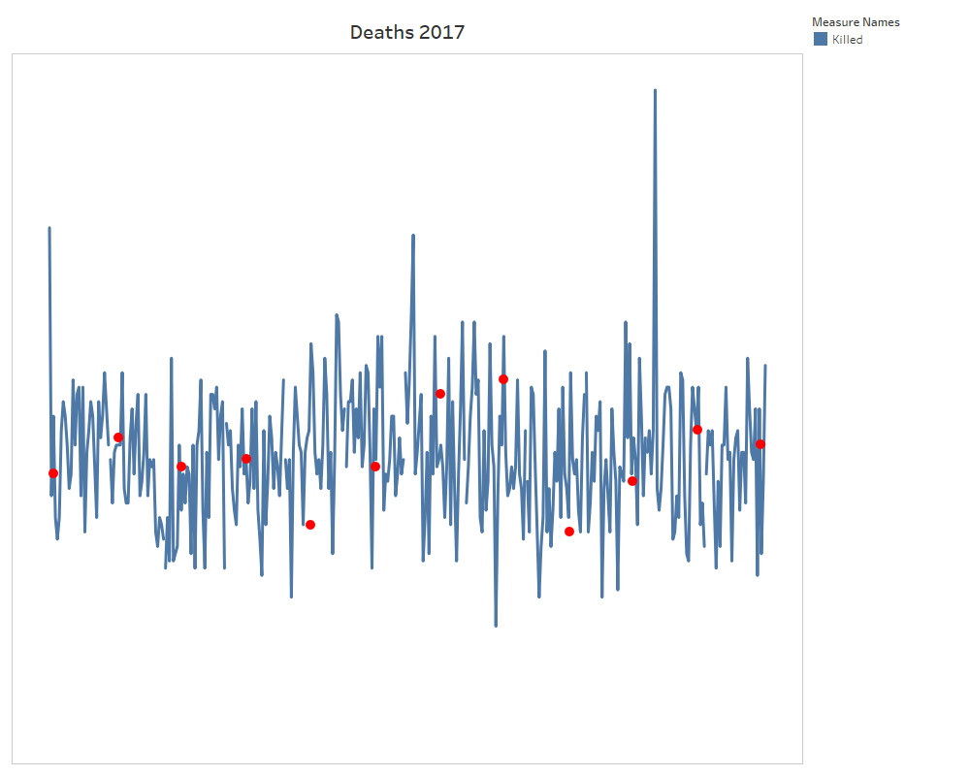

Slide 6
